Slide 1

JAVA Project
2021315385 이건
Gun Daniel Lee

Slide 2
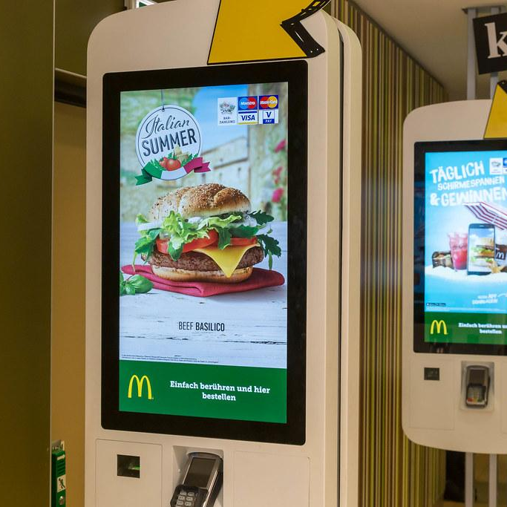

Description
Subway KIOSK System
Self-ordering
Store managing

Slide 3

Objective
To reduce the ordering time in Subway branches and to simplify product management

Slide 4


Owner Features

Slide 5
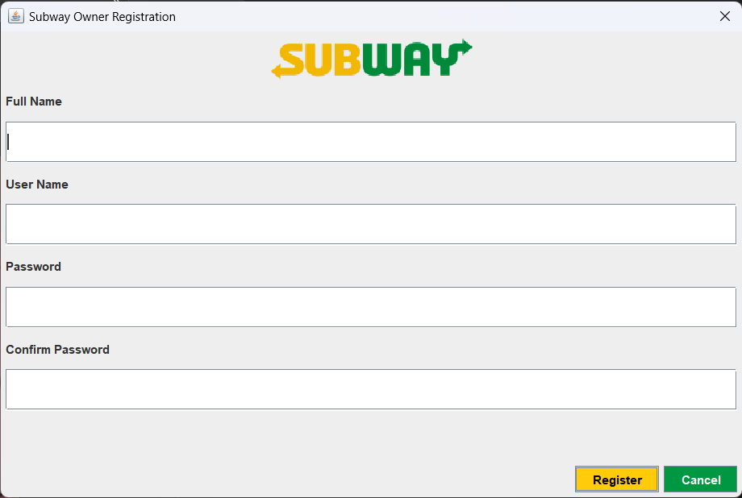
Registration
Register as owner
Update owner information

Slide 6
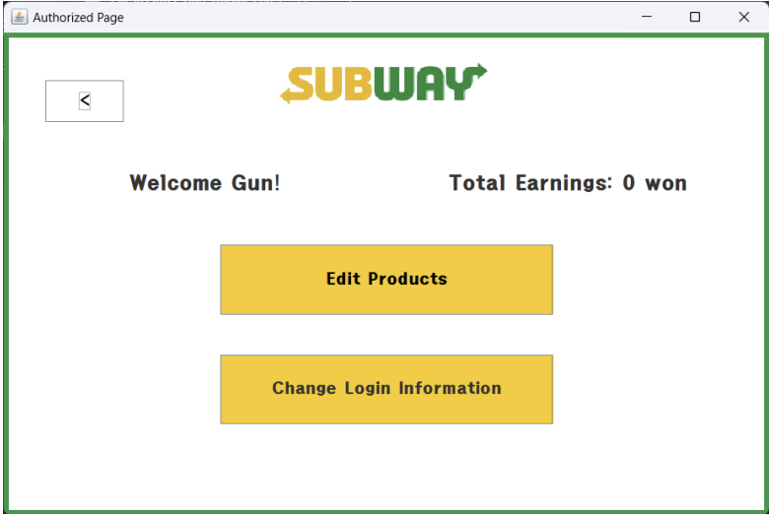
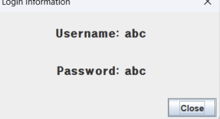
Information
Access
Accessed by login
Check earnings
and login information

Slide 7
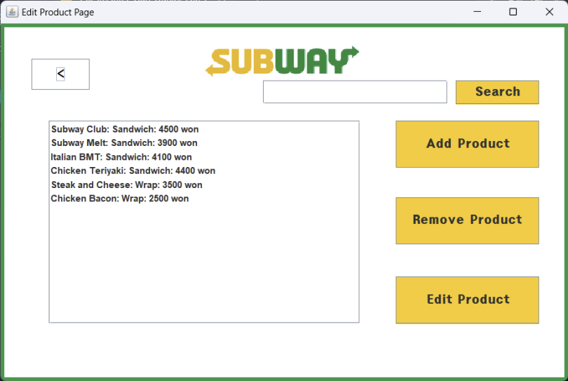
Product Management
Add, remove, or edit product list

Slide 8
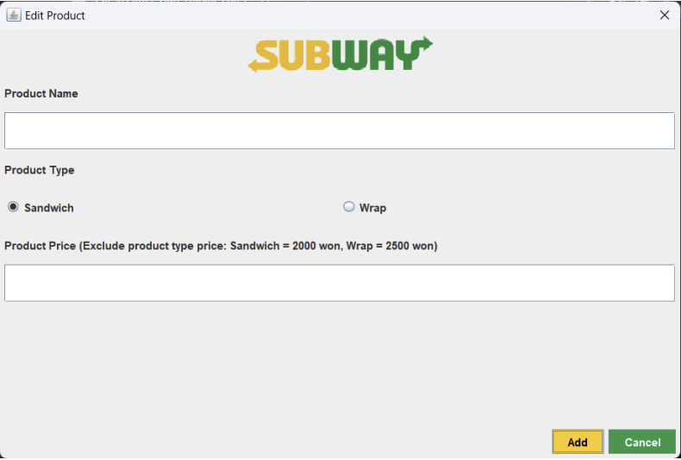
Product Management
Add, remove, or edit product list

Slide 9
Customer Features

Slide 10
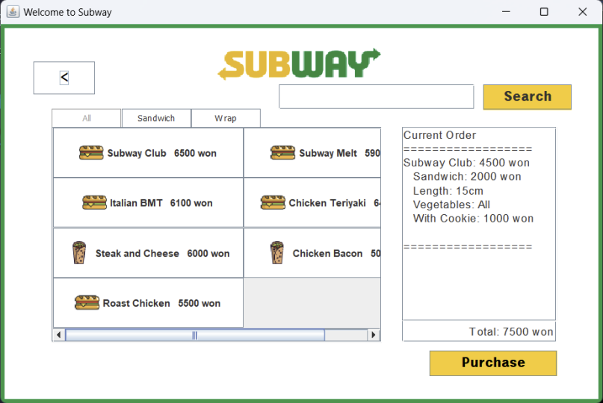
Product
Purchase
Search for products
Purchase products
with specifications

Slide 11
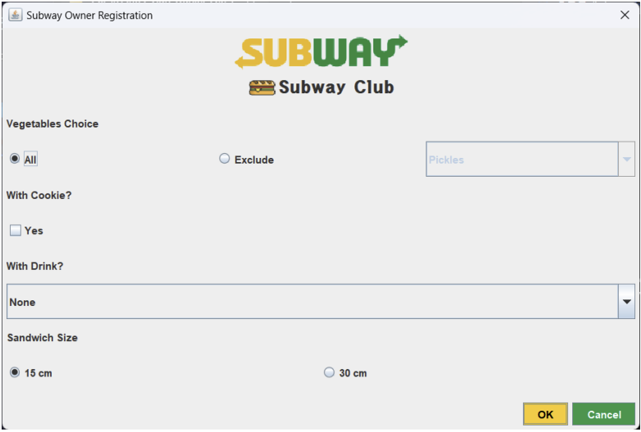
Product
Purchase
Search for products
Purchase products
with specifications

Slide 12
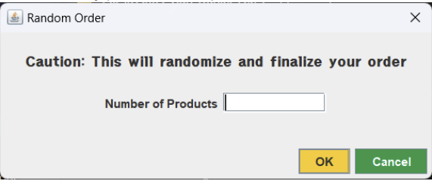
Randomized
Purchase
Randomize product purchase

Slide 13
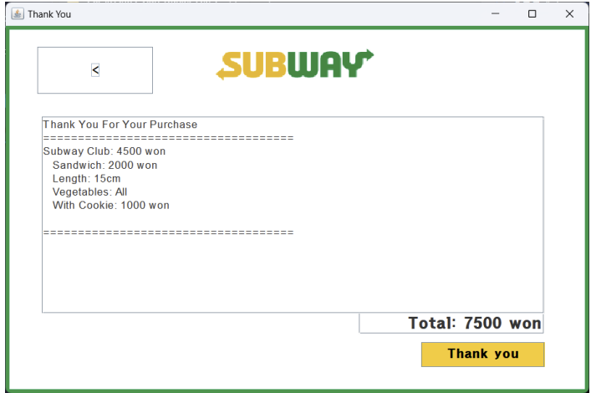
Review
Purchase
Check the finalized purchase

Slide 14
Thank You!

